Slide 1

Department of ECE
Analog electronic Circuit Design
24ec2104
Topic:
Open loop Configurations

Slide 2



AIM OF THE SESSION
This session aims to discuss the open loop configurations of the op-amp.
INSTRUCTIONAL OBJECTIVES
This Session is designed to:
  Understand the working of op-amp in open loop mode.
  Discuss the working of op-amp in Differential mode .
  Discuss the significance of inverting and non-inverting amplifier.
LEARNING OUTCOMES
At the end of this session, you should be able to:
  Understand the working of op-amp in open loop configuration.
  Differentiate between inverting and non-inverting amplifier modes.

Slide 3
Open Loop Configurations
In the case of amplifiers, the term open loop indicates that there is no connection, either direct or via another network, exists between the output and input terminals. When connected in an open-loop configuration, the Op-Amp simply functions as a high-gain amplifier.
There are three open-loop Op-Amp configurations.
1. Differential Amplifier
2. Inverting Amplifier
3. Non-Inverting Amplifier
These configurations are classed according to the inputs used and the terminal to which the input is applied when a single input is used.

Slide 4
Differential Amplifier
Input signals V_{in1} and V_{in2} are applied to the positive and negative input terminals . Since the Op-Amp amplifies the difference between the two input signals , this configuration is called the Differential Amplifier.
The Op-Amp is a versatile device because it amplifies both ac and dc input signals . This means that V_{in1} and V_{in2} could be either ac or dc voltages . The source resistances R_{in1} and R_{in2} are normally negligible compared to the input resistance R_{i} . Therefore the voltage drops across these resistors can be assumed to be zero , which then implies that V₁=V_{in1} and V₂=V_{in2} .
Hence V_{o}=A(V_{in1}-V_{in2})
Gain A is commonly referred to as open-loop gain, in such configurations.

Slide 5
Inverting Amplifier
In the Inverting Amplifier only one input is applied and that is to the inverting input terminal. The Non-Inverting input terminal is grounded. So V₁=0 V and V₂=V_{in}.
V_{o}=-AV_{in}
The negative sign indicates that the output voltage is out of phase for the input by 180 degrees or is of opposite polarity. In the Inverting Amplifier, the input signal is amplified by gain A and is also inverted at the output.

Slide 6
Non-Inverting Amplifier
In this configuration the input is applied to the non-inverting input terminal and the inverting terminal is connected to the ground. So that V₁=V_{in} and V₂=0V
Vo=AV_{in}
This means that the output voltage is larger than the input voltage by gain A and is in phase with the input signal.

Slide 7
Limitations of Open-Loop Configuration
Clipping occurs when the output attempts to exceed the saturation levels of op-amp.
Open-loop gain is not a constant and varies with temperature and power supply.
Bandwidth (band of frequencies for which gain remains constant) of open-loop op-amp is negligibly small.
Hence, open-loop configuration is not suitable for linear applications.
Op-Amps with negative feedback are used in linear applications.

Slide 8
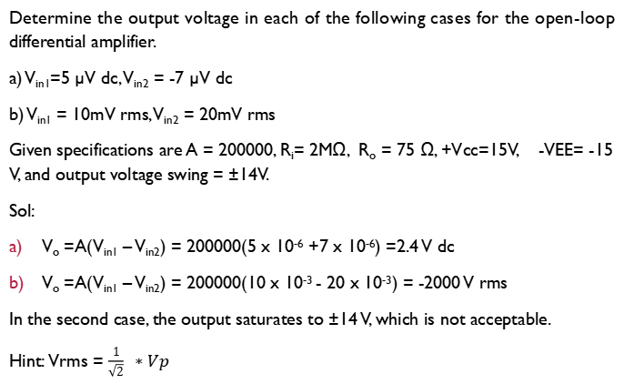
Example
Determine the output voltage in each of the following cases for the open-loop differential amplifier.
a) V_{in1}=5 µV dc, V_{in2} = -7 µV dc
b) V_{in1} = 10mV rms, V_{in2} = 20mV rms
Given specifications are A = 200000, R_{i}= 2MΩ, R_{o} = 75 Ω, +Vcc=15V, -VEE= -15 V, and output voltage swing = ±14V.
Sol:
V_{o} =A(V_{in1} – V_{in2}) = 200000(5 x 10⁻⁶ +7 x 10⁻⁶) =2.4 V dc
V_{o} =A(V_{in1} – V_{in2}) = 200000(10 x 10⁻³ - 20 x 10⁻³) = -2000 V rms
In the second case, the output saturates to ±14 V, which is not acceptable.
Hint: Vrms = $\frac{1}{\sqrt{2}} ∗Vp$

Slide 9

SELF-ASSESSMENT QUESTIONS
Open loop op-amp configuration has
a) Direct network between output and input terminals
b) No connection between output and feedback network
c) No connection between input and feedback network
d) All of the mentioned
What happen if any positive input signal is applied to open-loop configuration?
a) Output reaches saturation level
b) Output voltage swing’s peak to peak
c) Output will be a sine waveform
d) Output will be a non-sinusoidal waveform

Slide 10
SELF-ASSESSMENT QUESTIONS
3. Why open-loop op-amp configurations are not used in linear applications?
Output reaches positive saturation
b) Output reaches negative saturation
c) Output switches between positive and negative saturation
d) Output reaches both positive and negative saturation
4. The output voltage of an open-loop differential amplifier is equal to
a) Double the difference between the two input voltages
b) Product of voltage gain and individual input voltages
c) Product of voltage gain and the difference between the two input voltages
d) Double the voltage gain and the difference between two input voltages

Slide 11
ANSWERS
b
a
c
c

Slide 12
TERMINAL QUESTIONS
List three open-loop op-amp configurations.
Explain why open-loop op-amp configurations are not used in linear applications.
Discuss the working on open-loop non-inverting amplifier with relevant equations.
Illustrate the behavior of open-loop differential amplifier.

Slide 13
REFERENCES FOR FURTHER LEARNING OF THE SESSION
Reference Books:
1. Op-Amps and Linear Integrated Circuit; 4th Ed., Gayakwad, Ramakant A.
Sites and Web links:
1https://www.allaboutcircuits.com/textbook/semiconductors/chpt-8/op-amp-practical-considerations/

Slide 14
THANK YOU
Team – AECD

